Slide 1
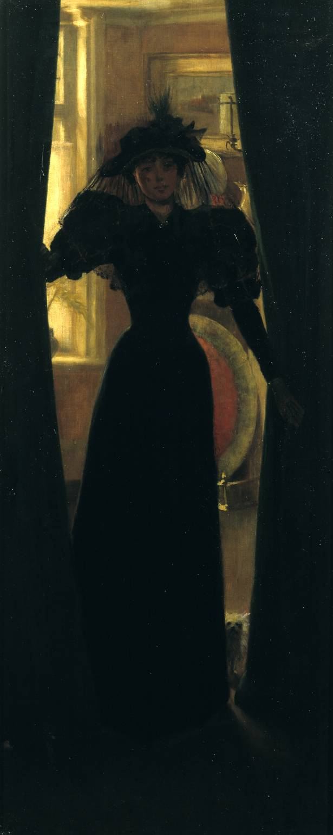
Kerr, The Visitor (1905)

Slide 2
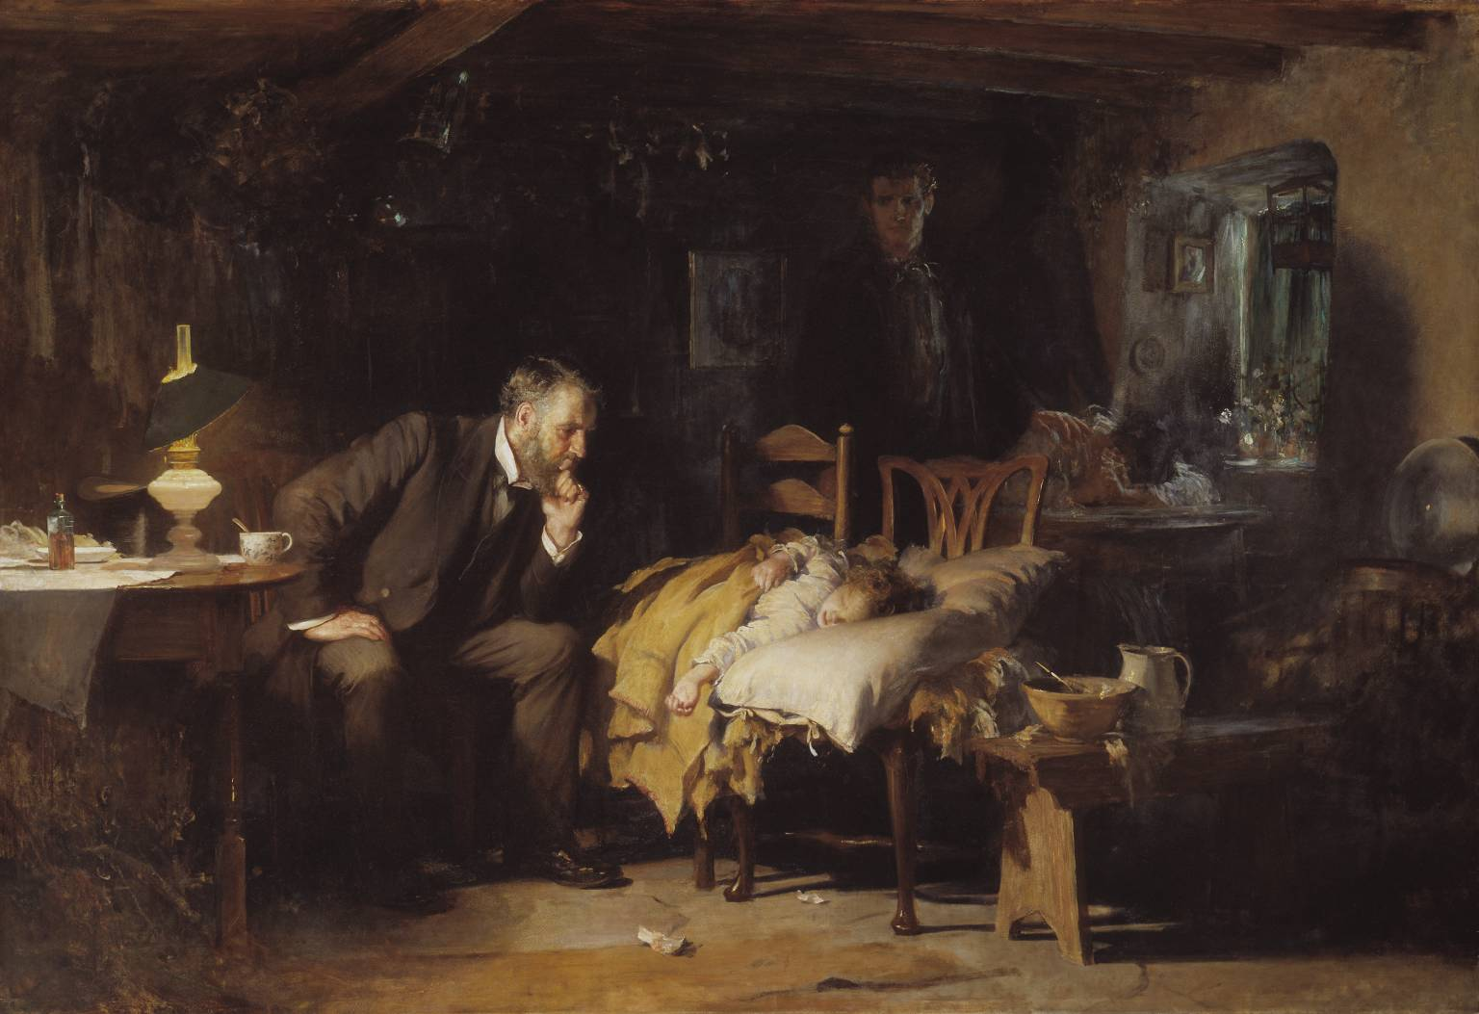
Fides, The Doctor (exhibited 1891)

Slide 3
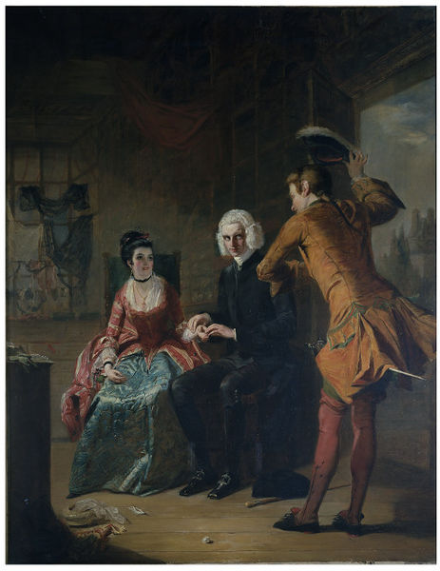
Frith, Scene from A Sentimental Journey (1841)

Slide 4
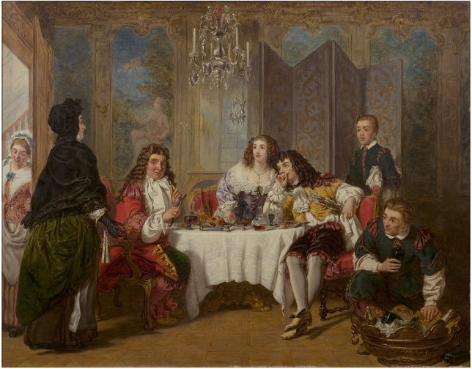
Frith, Scene from Le Bourgeois Gentilhomme: Madame Jourdain Finds her husband entertaining Dorimene and Dorante (1860)

Slide 5
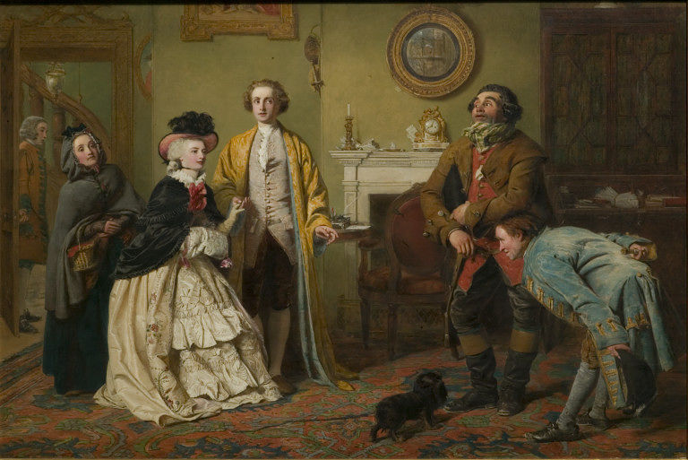
Frith, Mr Honeywood Introduces the Bailiffs to Miss Richland as his Friends; Goldsmith’s ‘The Good-Natured Man’. Act III, Scene 1 (1850)

Slide 6
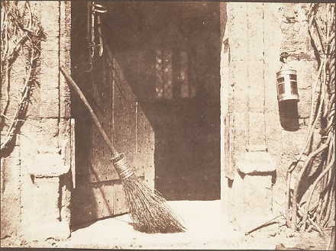
Talbot, The Open Door (1844)

